Slide 1
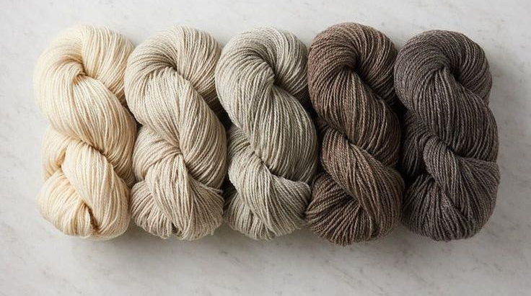
Merino Wool
THE ULTIMATE GUIDE TO UNDERSTANDING ITS QUALITY AND BENEFITS!​

Slide 2
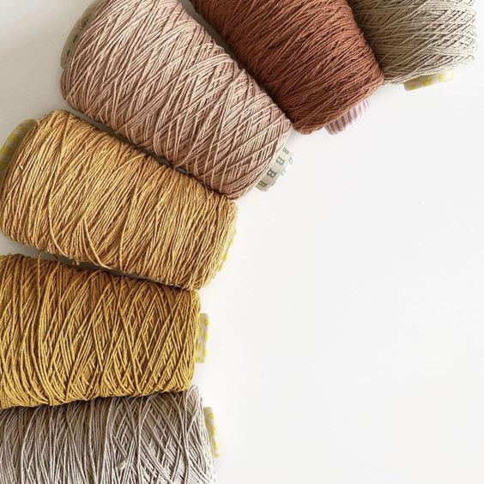
Merino Wool
Why Merino Wool Matters Merino wool, a premium and versatile fiber, is celebrated for its exceptional qualities that set it apart in the fashion and outdoor gear industries. Its unparalleled softness, durability, and sustainability make it a top choice for discerning consumers seeking high-quality apparel.

Slide 3
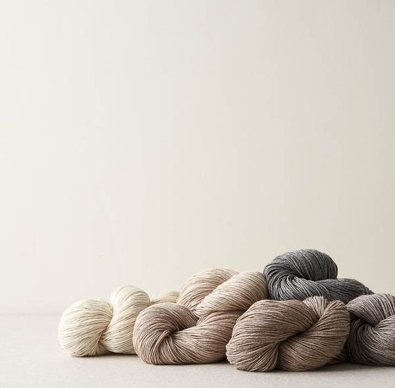
Fundamentals of Merino Wool Merino wool comes from the Merino sheep, a breed known for producing extremely fine and soft fibers. These fibers typically range from 15 to 24 microns in diameter, making Merino wool significantly softer than traditional wool. Key characteristics of Merino wool include:
Softness: The fine diameter of Merino wool fibers makes it incredibly soft and comfortable against the skin.
Temperature Regulation: Merino wool helps keep you warm in cold weather and cool in hot weather due to its excellent thermoregulation properties.
Moisture Management: It efficiently wicks moisture away from the skin, keeping you dry and comfortable.
Odor Resistance: Merino wool naturally resists Odors by absorbing Odor-causing bacteria.
Breathability: Its porous fibers allow for excellent air circulation.
Durability: Merino wool fibers are resilient and can stretch without breaking, contributing to the longevity of garments.
Sustainability: Merino wool is a natural, renewable, and biodegradable fiber.
Merino Wool

Slide 4
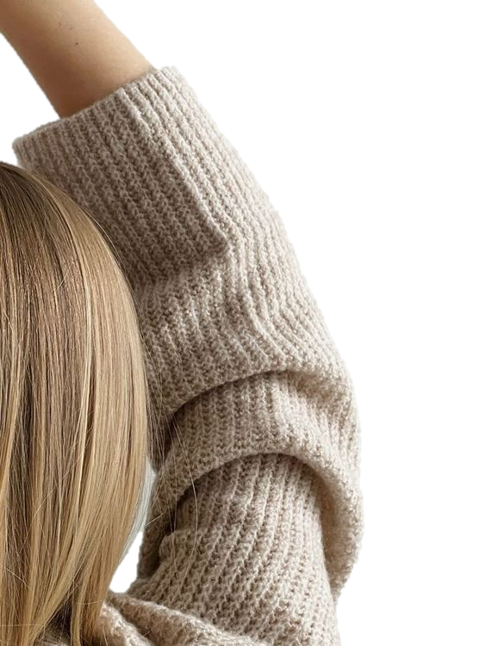
Grading Merino Wool The quality of Merino wool is primarily determined by its micron count, with lower numbers indicating finer and softer wool:
Ultrafine Merino Wool: Less than 15 microns.
Superfine Merino Wool: 15 to 18.5 microns.
Fine Merino Wool: 18.6 to 19.5 microns.
Medium Merino Wool: 19.6 to 22.9 microns.
Broad Merino Wool: 23 to 24.5 microns.
Lower micron counts result in softer, more luxurious fabrics, while higher micron counts produce more durable wool.
Merino Wool

Slide 5
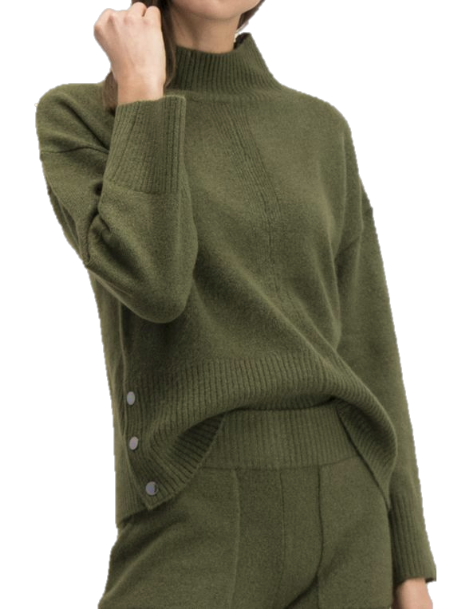
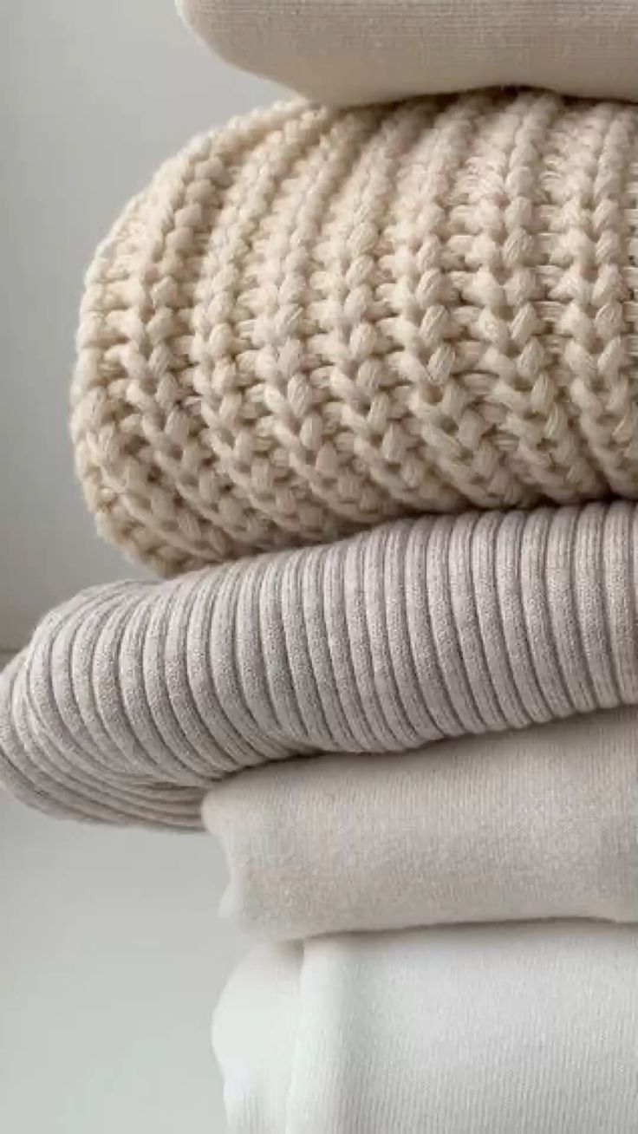
Merino Wool
Beyond the Grade: Impact of Spinning and Yarn Quality
The quality of Merino wool extends beyond its micron count. Spinning and yarn quality significantly impact the final product. Key factors include:
Fiber Length: Longer fibers produce smoother and more durable yarns with less pilling.
Processing Methods: Gentle cleaning and spinning techniques preserve the natural properties of Merino wool, enhancing its softness and durability.
Blend Quality: While pure Merino wool is highly prized, high-quality blends (e.g., Merino-silk) can enhance certain properties of the fabric.
Finishing Treatments: Additional treatments, such as water resistance or machine washability, can affect the overall quality and performance of Merino wool products.

Slide 6
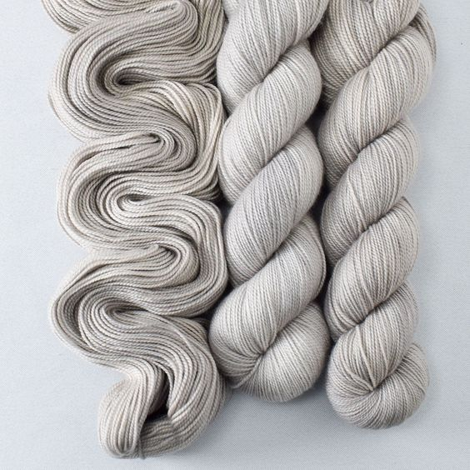
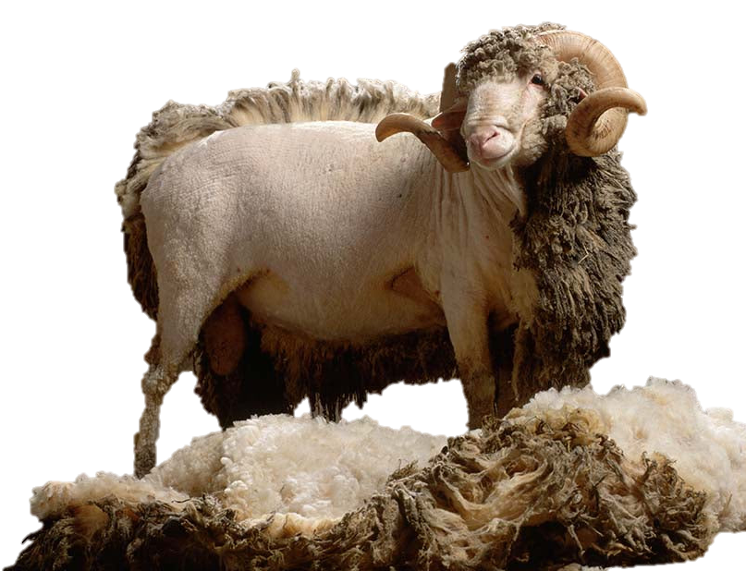
Practical Tips for Selecting Merino Wool When choosing Merino wool products, consider the following tips:
Check the Micron Count: Look for lower micron counts for softer, finer wool.
Look for Certifications: Certifications like the Responsible Wool Standard (RWS) and OEKO-TEX Standard 100 indicate quality and ethical production.
Examine the Fabric Composition: High-quality products often contain 100% Merino wool or a high percentage of it.
Assess the Brand Reputation: Established brands known for their Merino wool products often have rigorous quality control processes.
Feel and Appearance: High-quality Merino wool should feel soft to the
touch and have a consistent appearance without visible inconsistencies.
Performance Properties: Ensure the product exhibits excellent moisture-
wicking, temperature regulation, and Odor-resistance properties.
Merino Wool

Slide 7
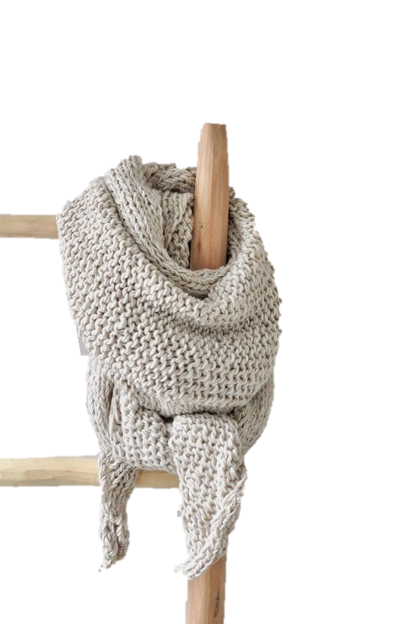
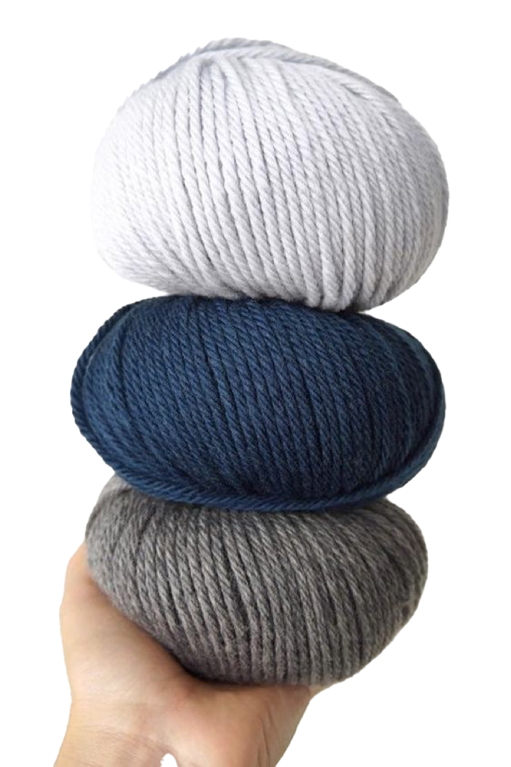
Contempo’s Commitment to Quality and Customer Satisfaction
At Contempo, we provide our customers with the finest Merino wool products. Our commitment to quality is reflected in our rigorous sourcing and processing standards, ensuring that every garment meets the highest benchmarks for softness, durability, and sustainability. We prioritize ethical sourcing and transparent supply chain practices, ensuring that our Merino wool is responsibly produced from farm to finished product.
Merino Wool

Slide 8
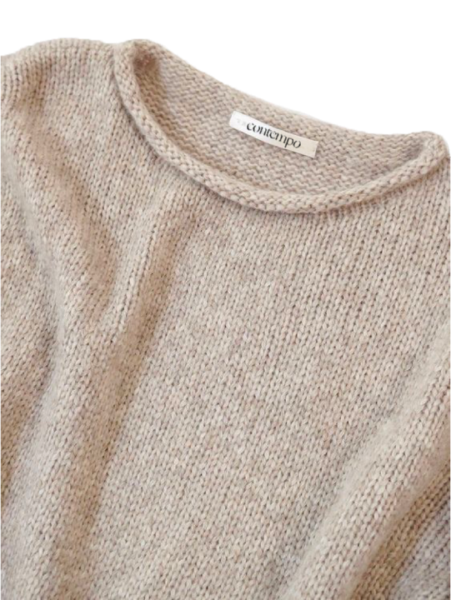
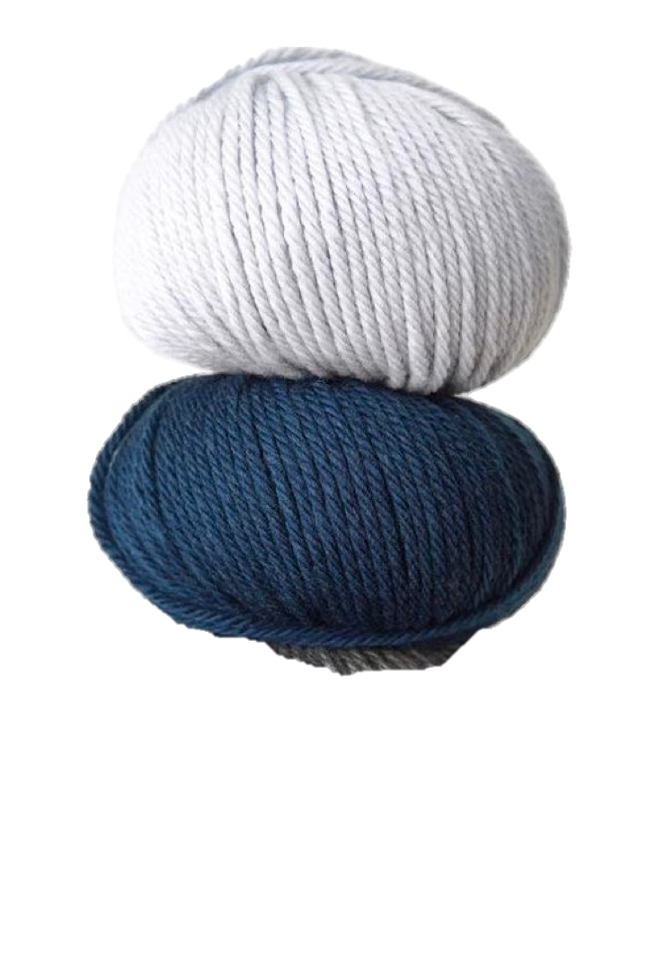
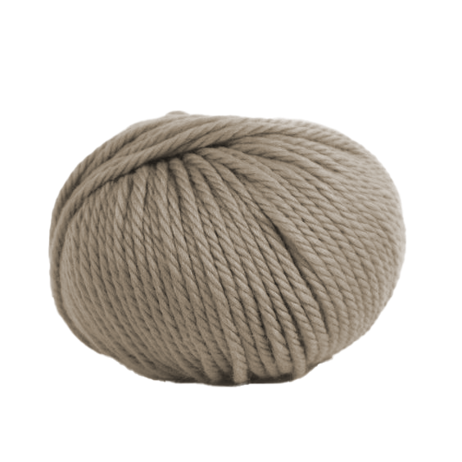
Merino Wool
Our customers' satisfaction is paramount.
We strive to offer exceptional products that deliver unparalleled comfort and performance. Whether you are an outdoor enthusiast or a fashion aficionado, Contempo's Merino wool products are designed to exceed your expectations.
Experience the unmatched benefits of Merino wool with Contempo's top-tier products. Discover ultimate comfort, durability, and sustainability.
Reach out to our experts now
to explore our range and to learn more.

